Slide 1
IST 659 - Machine Learning in High frequency trading
- Anuj Jain

Slide 2
What is Machine Learning?
Artificial Intelligence technique that provides computers the ability to learn
There is no need for explicit programming
Use of statistical techniques such as linear regression, logistic regression for learning
Machine Learning
Reinforcement Learning
Supervised Learning
Unsupervised Learning

Slide 3
What is HFT?
Automated trading platform
Allows traders to execute millions of orders
Helps in maintaining competitive advantage
Based on machine learning algorithms
Increase in HFT due to incentives – added liquidity to the market
Unfair advantage to large institutions

Slide 4
Types of problems in trading
What is a regression problem?
Estimating a value of something
Measuring good or bad
Distance from the correct answer
What is a classification problem?
Trying to put data into a bucket
Measuring good or bad
Binary decision
Regression is used in most HFT firms
Classification is used by long term trading firms
Notes:
Estimating the percentage of votes that the democratic party will win? The measure of good or bad estimation is the mean squared error
Estimating returns on the stock

Slide 5
ML Algorithms used in HFT
Linear Regression
Logistic Regression
Time series modelling

Slide 6
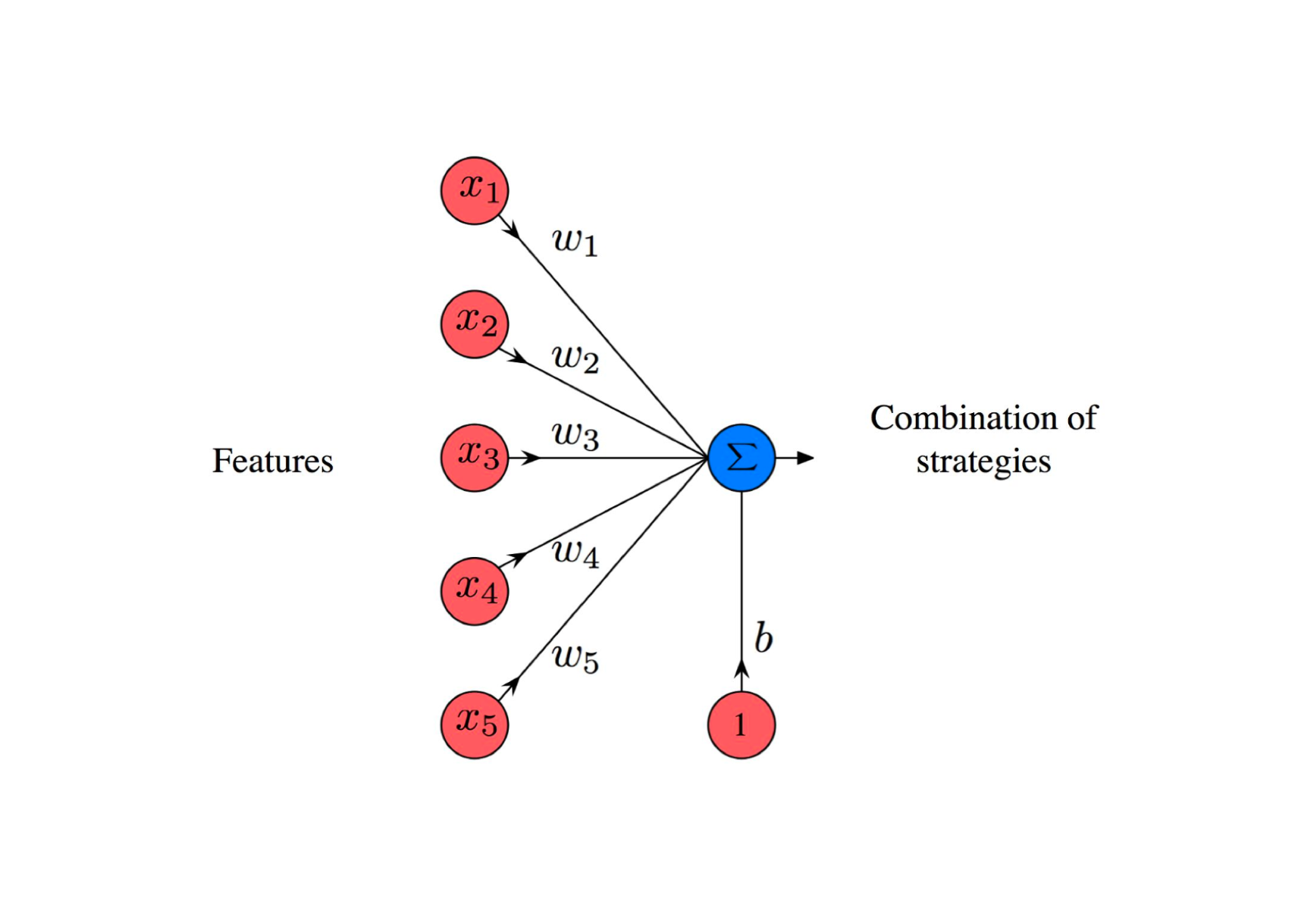
Linear Regression
All factors and features are into account
These factors are given weights
A value is estimated by calculated the weighted sum of all the features
It is the core of statistical arbitrage
Notes:
Estimating the sale price of an apartment

Slide 7
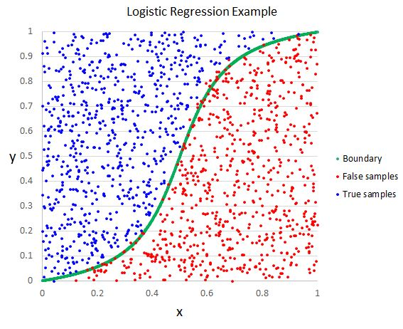
Logistic Regression
It is the go-to method for binary classification problems
Estimating the weighted sum of all the features/factors involved, same like linear regression
The outputs are put into buckets based on conviction
A feature may overpower the others

Slide 8
Time series analysis
A time series is a collection of data points in a particular time frame
Time series analysis is getting insights and extracting information using charts, plots
Time series forecasting is basically predicting values of features based on historical data
Core of this analysis is regression
Estimating weather conditions, heights of ocean tides

Slide 9
Thank You!

Slide 10
References
[1]Retrieved from https://www.qplum.co/documents/aifintech
[2]Retrieved from https://www.investopedia.com/ask/answers/09/high-frequency-trading.asp
[3]Retrieved from https://www.investopedia.com/terms/h/high-frequency-trading.asp

